Slide 1
Python Namespace
Name (also called identifier) is simply a name given to objects. Everything in Python is an object. Name is a way to access the underlying object.
For example, when we do the assignment a = 2, here 2 is an object stored in memory and a is the name we associate it with. We can get the address (in RAM) of some object through the built-in function, id(). Let's check it.
a = 2
# Output: id(2)= 10919424
print('id(2) =', id(2))
# Output: id(a) = 10919424
print('id(a) =', id(a))
What is a Namespace in Python?
To simply put it, namespace is a collection of names.
In Python, you can imagine a namespace as a mapping of every name, you have defined, to corresponding objects.

Slide 2
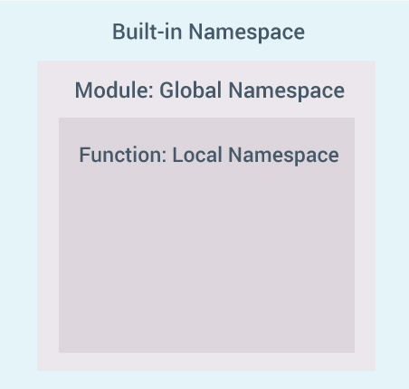

Slide 3
Python Variable Scope
Scope is the portion of the program from where a namespace can be accessed directly without any prefix.
At any given moment, there are at least three nested scopes.
Scope of the current function which has local names
Scope of the module which has global names
Outermost scope which has built-in names

Slide 4
Example of Scope and Namespace in Python
def outer_function():
b = 20
def inner_func():
c = 30
a = 10
Explanation : Here, the variable a is in the global namespace. Variable b is in the local namespace of outer_function() and c is in the nested local namespace of inner_function().
When we are in inner_function(), c is local to us, b is nonlocal and a is global. We can read as well as assign new values to c but can only read b and c from inner_function().
If we try to assign as a value to b, a new variable b is created in the local namespace which is different than the nonlocal b. Same thing happens when we assign a value to a.
However, if we declare a as global, all the reference and assignment go to the global a. Similarly, if we want to rebind the variable b, it must be declared as nonlocal.

Slide 5
def outer_function():
a = 20
def inner_function():
a = 30
print('a =',a)
inner_function()
print('a =',a)
a = 10
outer_function()
print('a =',a)

